Slide 1






Lecture 3:
Modern DOM Selectors
Course - Web Development - II
-By
Instructor Name
welcome@krmangalam.edu.in
Sohna Road,Gurugram,Haryana 122103

Slide 2

| Table of Contents
querySelector()
querySelectorAll()
NodeList vs HTMLCollection
References.
The End.

Slide 3
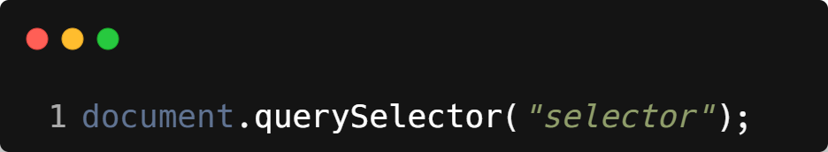
| querySelector()
Selects the first element that matches a CSS selector.
More powerful and flexible than getElementById().
Syntax :
Returns only the first matching element.
You can use any CSS selector: class (.card), id (#main), tag (div), etc.

Slide 4
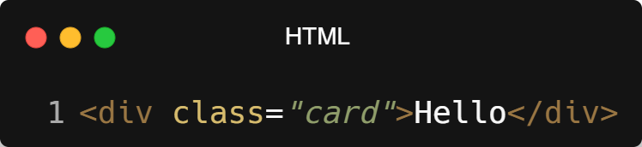
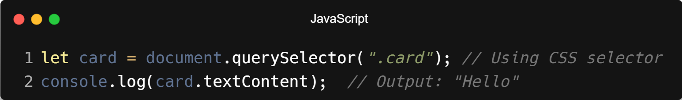
| querySelector()
Example :

Slide 5
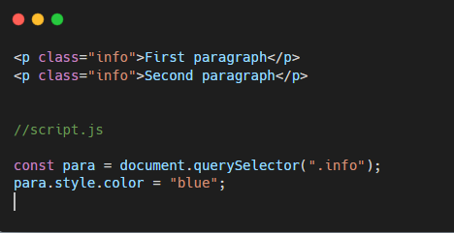
| querySelector()
Example :
Only the first paragraph is selected.

Slide 6
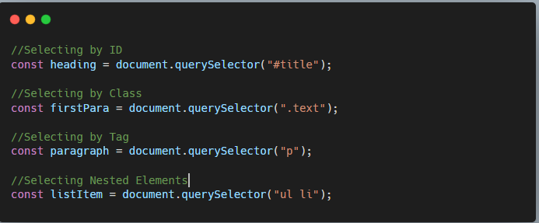
| querySelector()
Example :

Slide 7
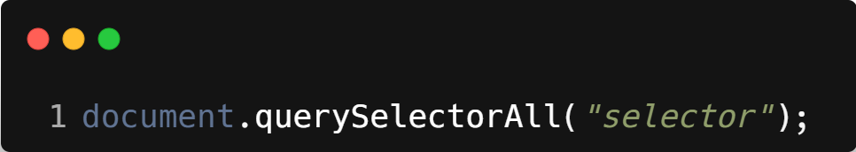
| querySelectorAll()
Selects all elements that match a CSS selector.
Returns a NodeList (can be looped using forEach()).
Syntax :
Returns a NodeList, not live (unlike getElementsByClassName()).
Supports full CSS selector syntax, and allows easy iteration.

Slide 8
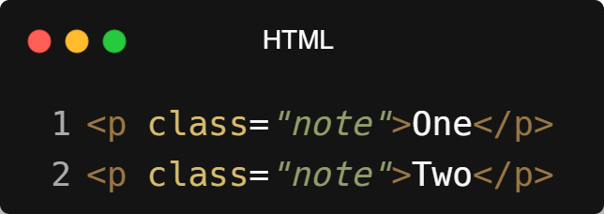
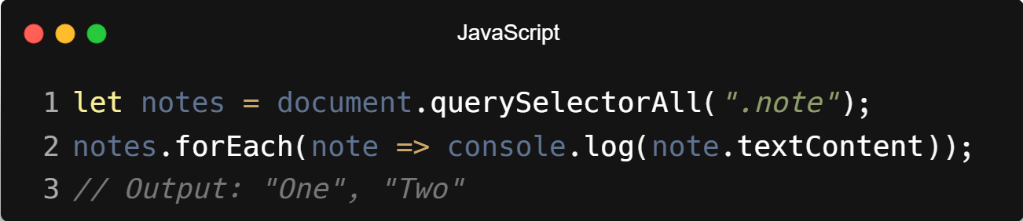
| querySelectorAll()
Example :

Slide 9
| NodeList vs HTMLCollection
Introduction
When selecting multiple elements from the DOM, JavaScript returns either a NodeList or an HTMLCollection. Both represent collections of nodes, but they differ in behavior and usage

Slide 10
| NodeList vs HTMLCollection
NodeList
A NodeList is a collection of nodes returned by:
querySelectorAll()
childNodes
Characteristics
Can include element nodes and text nodes
Usually static (does not update automatically)
Supports forEach() method
Indexed like an array (but not an actual array)

Slide 11
| NodeList vs HTMLCollection
HTMLCollection
An HTMLCollection is a collection of HTML elements only, returned by:
getElementsByClassName()
getElementsByTagName()
children
Characteristics
Contains only element nodes
Always live (updates automatically when DOM changes)
Does not support forEach() directly

Slide 12

| Check Your Understanding
Question : What is the main difference between querySelector() and querySelectorAll()?
Options : a) querySelector() is newer and faster than querySelectorAll().
b) querySelector() returns the first element that matches a CSS selector, while querySelectorAll()
returns a list of all matching elements.
c) querySelector() can only use ID selectors, while querySelectorAll() can use class selectors.
d) querySelector() returns a live collection, while querySelectorAll() returns a static list.
Answer : b) querySelector() returns the first element that matches a CSS selector,
while querySelectorAll() returns a list of all matching elements.
Explanation:
You use querySelector() when you only need the first match, and querySelectorAll() when you need to access or iterate over all elements that match a selector.

Slide 13
| References
MDN Web Docs : Comprehensive and official documentation for JS.
🔗https://developer.mozilla.org/en-US/docs/Web/JavaScript
W3Schools – JS Tutorial : Beginner-friendly JS tutorials with examples and interactive editors.
🔗 https://www.w3schools.com/js/
JavaScript.info - A comprehensive tutorial-style website that covers core JavaScript concepts in depth.
🔗https://javascript.info/

Slide 14
Thanks
For
Watching
Course - Web Development - II
welcome@krmangalam.edu.in
Sohna Road,Gurugram,Haryana 122103

